Slide 1
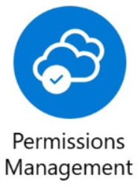
Entra Permissions Management

Slide 2
Agenda
High-level diagrams
Concept of the product
Demo
Pros & Cons
Documentation

Slide 3
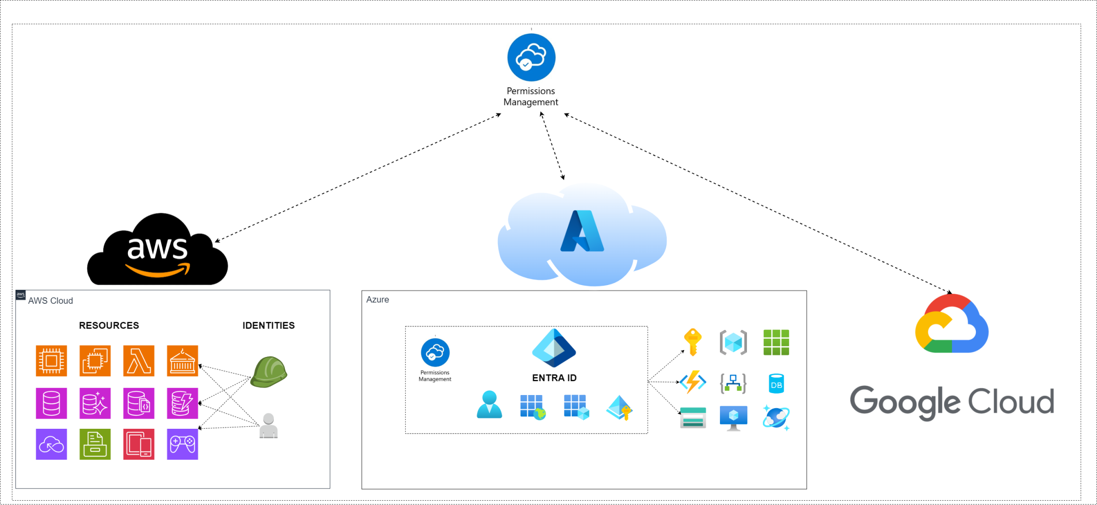
1. General high-level diagram

Slide 4
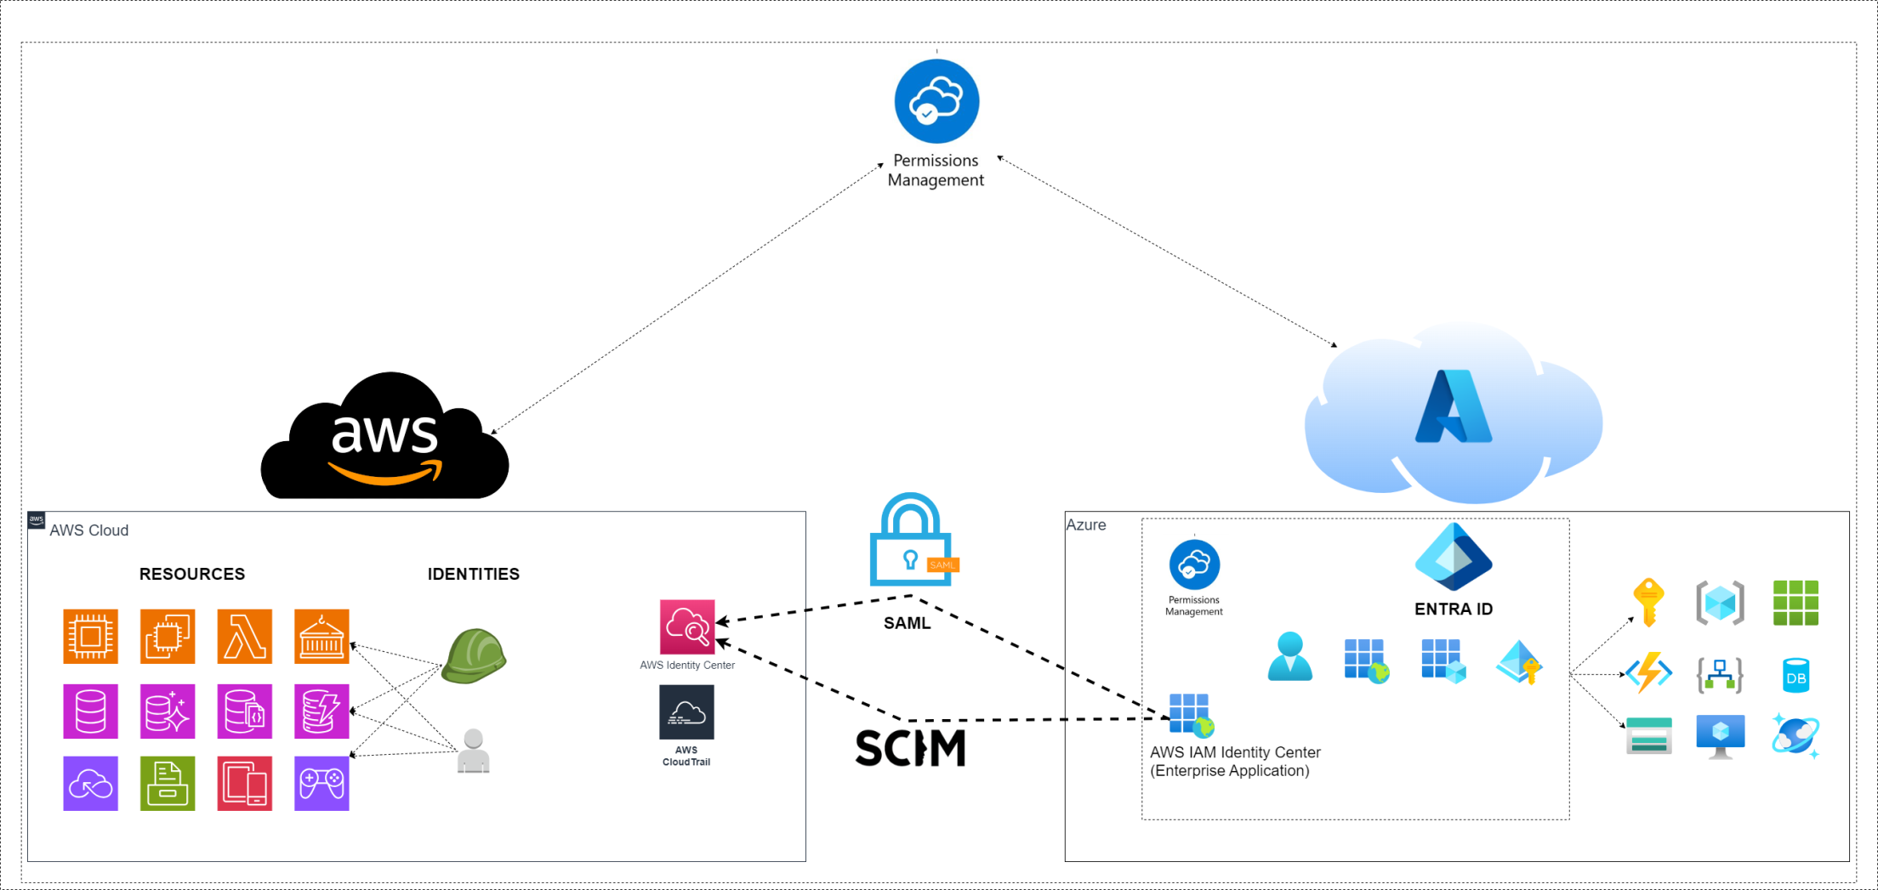
1. Demo high-level diagram

Slide 5

2. Concept of the product

Slide 6

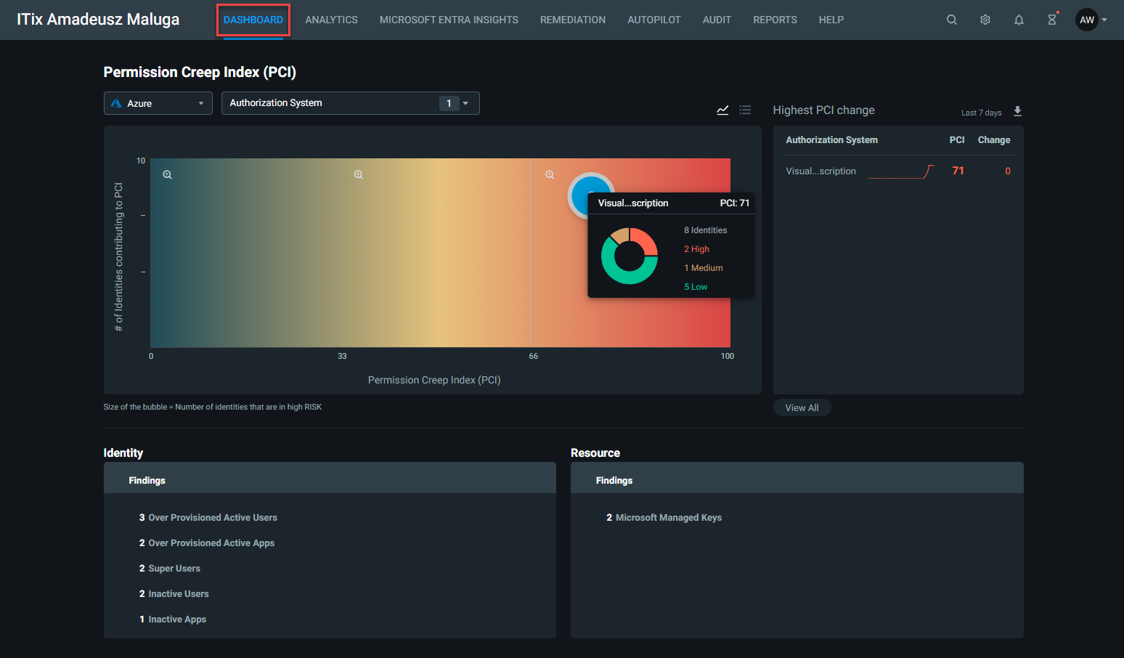
2. Concept of the product

Slide 7

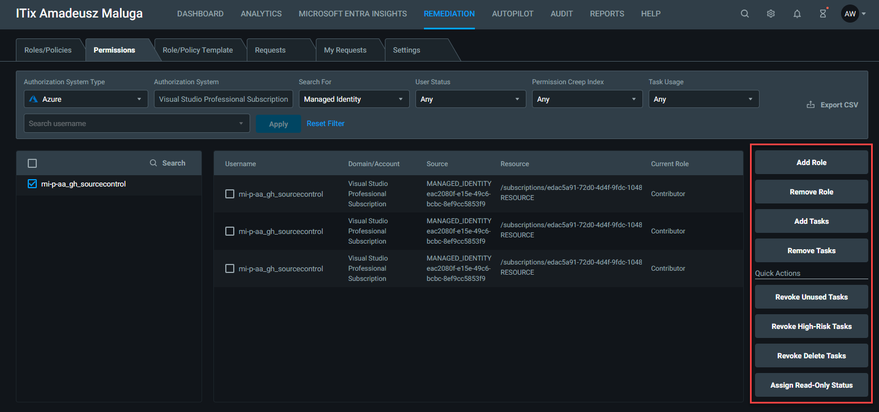
2. Concept of the product

Slide 8

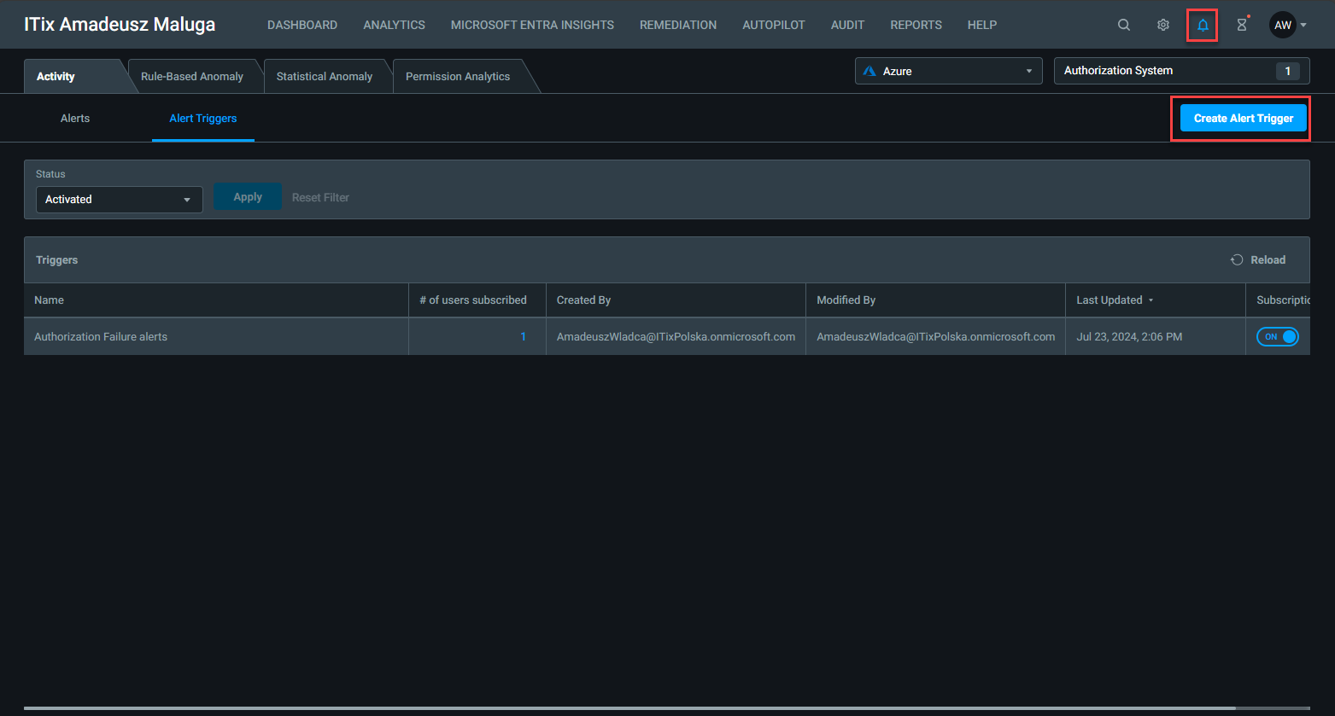
2. Concept of the product

Slide 9
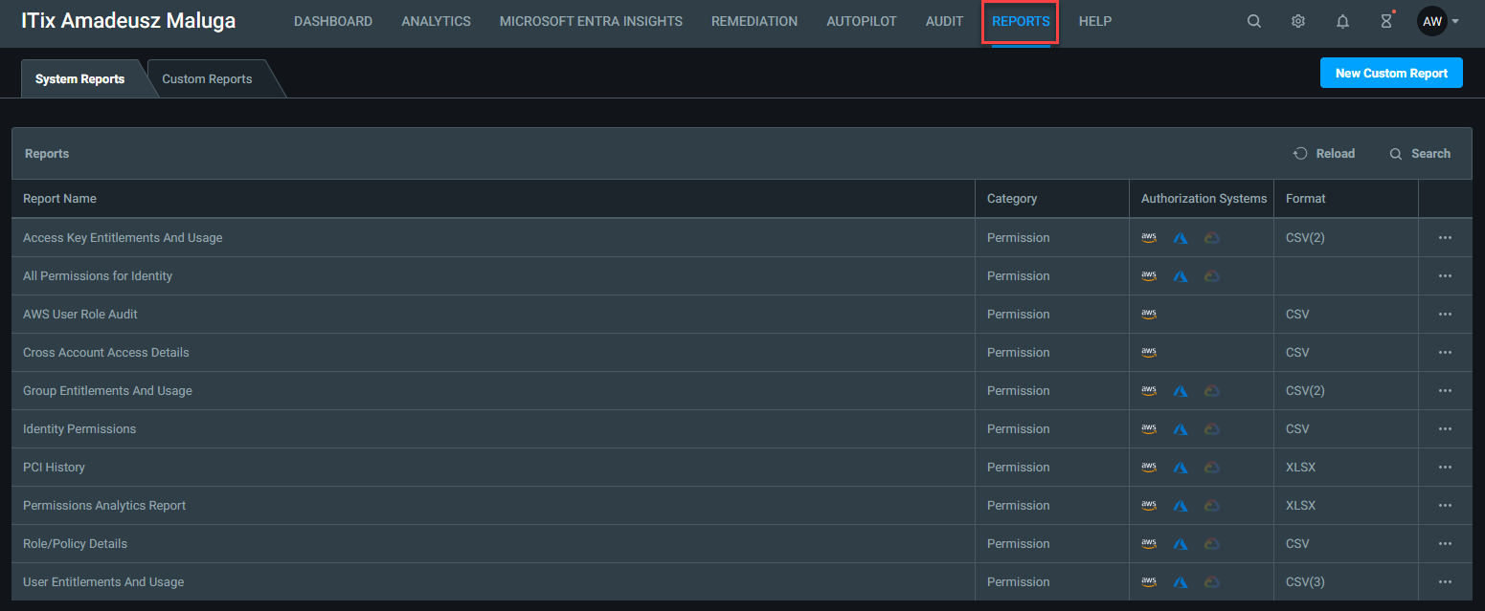
2. Concept of the product

Slide 10
4. Pros
for product that would be finished!: 1. Handy for creation of low privileged custom roles based on the historical activity of the users
2. Works well also for Managed Identities/Service Principals
3. Good for daily PCI monitoring in portal, easy way to create scheduled report.

Slide 11
4. Cons
1. Unfinished product - Doesn’t track every permission that identity performed, risk of revoking the accesses that shouldn’t be removed.
2. Pricing. (?)
3. It's focused only on Azure RBAC roles, there's almost no functionality for Entra ID administrative roles. - less than what included in Entra Admin Center: https://entra.microsoft.com/#view/Microsoft_AAD_IAM/AllRolesBlade
4. AUTOPILOT - Only the user who created the selected rule can create recommendations. Suggestion: Controller (EPM permission) should be able to trigger autopilot rules.
5. EPM -> User Management -> Permission Groups do not change the name after it's changed in Entra ID
6. Focuses mostly on create/update/delete rather than narrowing down READ accesses - e.g. in remediation -> permissions
7. Problematic for SPs that do actions not that often as at least once per 90 days.

Slide 12
5. Documentation
1. https://learn.microsoft.com/en-us/entra/permissions-management/ - general doc
2. https://learn.microsoft.com/en-us/entra/identity/role-based-access-control/delegate-by-task#permissions-management - Permissions Management Administrator - Entra ID role required to onboard new tenant, new cloud environment and assign permissions in Entra Permissions Management
3. Microsoft Entra Permissions Management Quickstart Guide - Microsoft Entra Permissions Management | Microsoft Learn – how to configure data collection for each cloud environment
4. How Microsoft Entra Permissions Management Works - Training | Microsoft Learn

